Slide 1

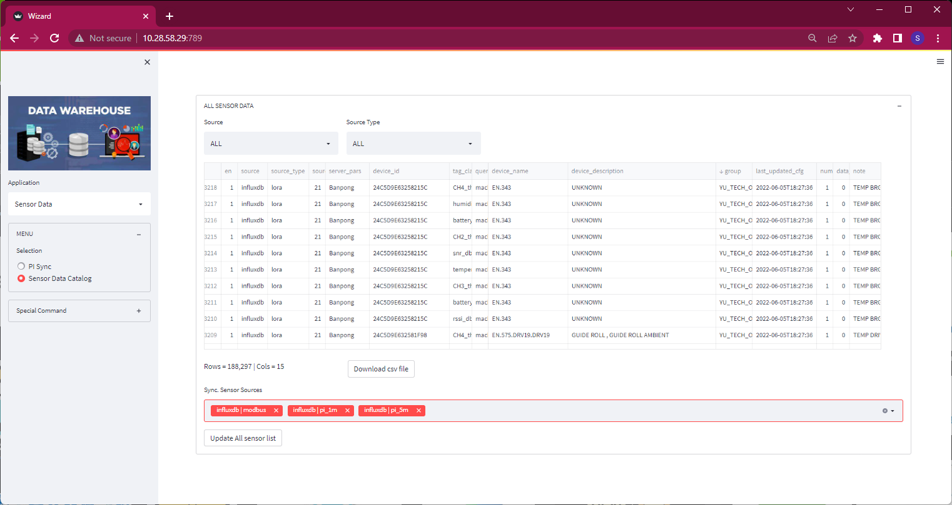



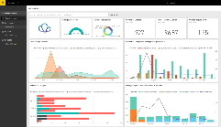

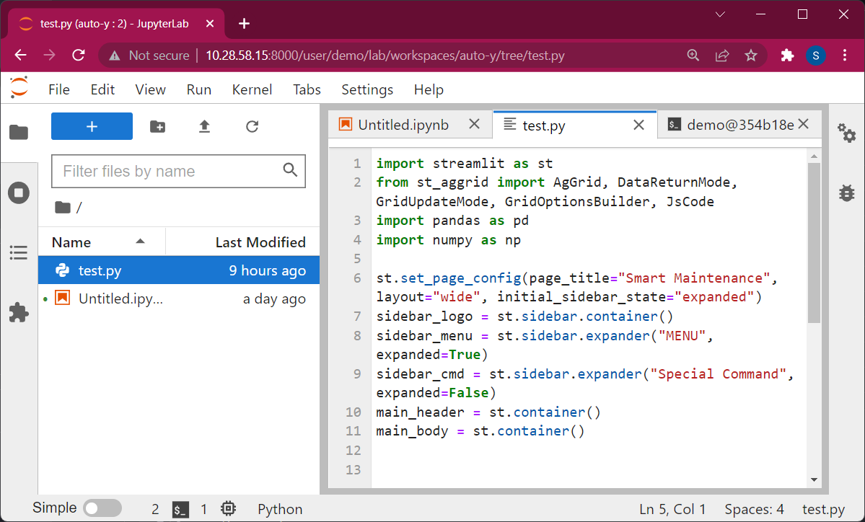
Self-Service Data Analytics Tool
Sensor Data Service Center
Simplify data query of various sensors, sources and servers into one simple interface standard
Sensor Data
Data Service Broker
Users
1.Sensor Data Catalog
For Basic Data Analytic
Direct access via PI-AF sdk (direct)
http://10.28.58.29:789
(SKIC, TCP, CIP, VKPC, UPPC, FAJAR, PPP)
csv
/json
PI buffer selective tag in 1min (pi_1m)
PI current data in 5min (pi_5m)
LoRa IOT
Wizard Series
Other IOT Brand
Modbus devices (modbus)
SKF Vibration (skf_vib)
System1 Vibration (system1)
Oil LAB (oil_lab)
Capstone TCP1,2 (capstone)
Other
For Visualization in PowerBI
Now having
> 250,000 data catalog
21 servers in 4 Countries
2.Application Protocol Interface
For Data Analytic & ML
Eg. http://10.28.58.29:788/api/sensor/mean/1h/json/wide?ids=35699,56180,69970

Slide 2
Self-Service Data Analytics Tool
Sensor Data Service Center
API Document | Point Information
http://10.28.58.29:788/api/sensor/parameters/<Output format>?sid=<Sensors ids>
Parameters | Description | Value
Output format | Data output format | json=json format (for powerBI) csv=csv format (for save to file or use in python)
Sensors ids | Sensor id separated by , (choose from sensor data catalog)
Example :
http://10.28.58.29:788/api/sensor/parameters/json?sid=9783,244310

Slide 3
Self-Service Data Analytics Tool
Sensor Data Service Center
API Document | Sensor data
http://10.28.58.29:788/api/sensor/<Agg. mode>/<Agg. time>/<Output format>/<Structure format>?sid=<Sensor ids>&start=<Start time>&end=<End time>&interpolate=<Interpolate mode>&limit=<Interpolate limit>
Parameters | Description | Value
Agg. mode | Aggregate mode | mean, median, mode, first, last
Agg. time | Aggregate time period | (unit : m,h,d)
Output format | Data output format | json=json format (for powerBI) csv=csv format (for save to file or use in python)
Structure format | Data structure format | wide, long
Sensors ids | Sensor id separated by , (choose from sensor data catalog)
Start time | Start time | Relative time from end time or Absolute time (format yyyy-mm-dd hh:mm:ss)
End time | End time | now() or Absolute time (format yyyy-mm-dd hh:mm:ss)
Interpolate mode | Interpolate mode for missing value | None, time, linear, pad, nearest
Interpolate limit | Maximum number of consecutive fill by interpolate
Ex. http://10.28.58.29:788/api/sensor/mean/5h/json/long?sid=9783,244310&start=-35d&interpolate=time&limit=3

Slide 4
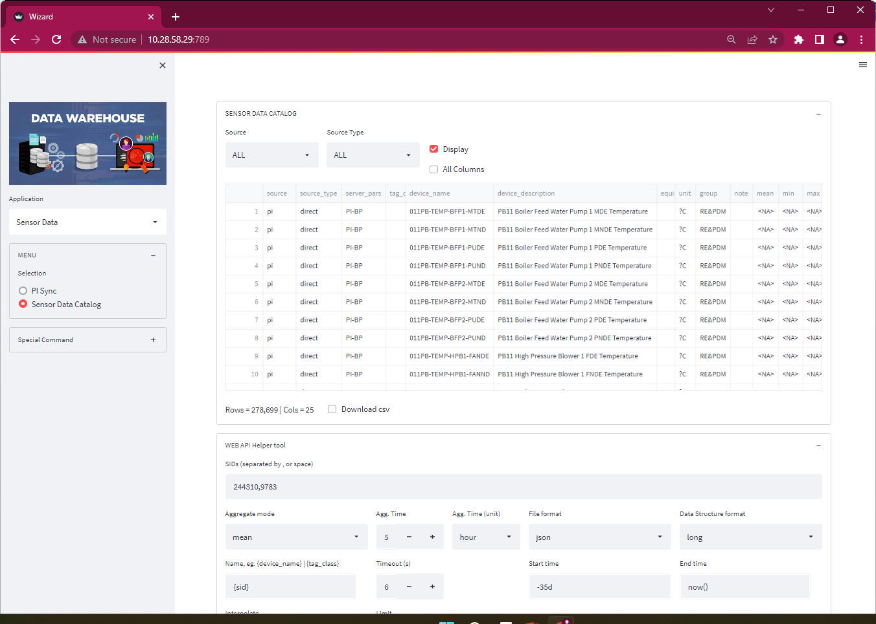
Self-Service Data Analytics Tool
Sensor Data Service Center
Sensor Data Catalog
http://10.28.58.29:789
Sensor Id
Download and choose id from Excel

Slide 5
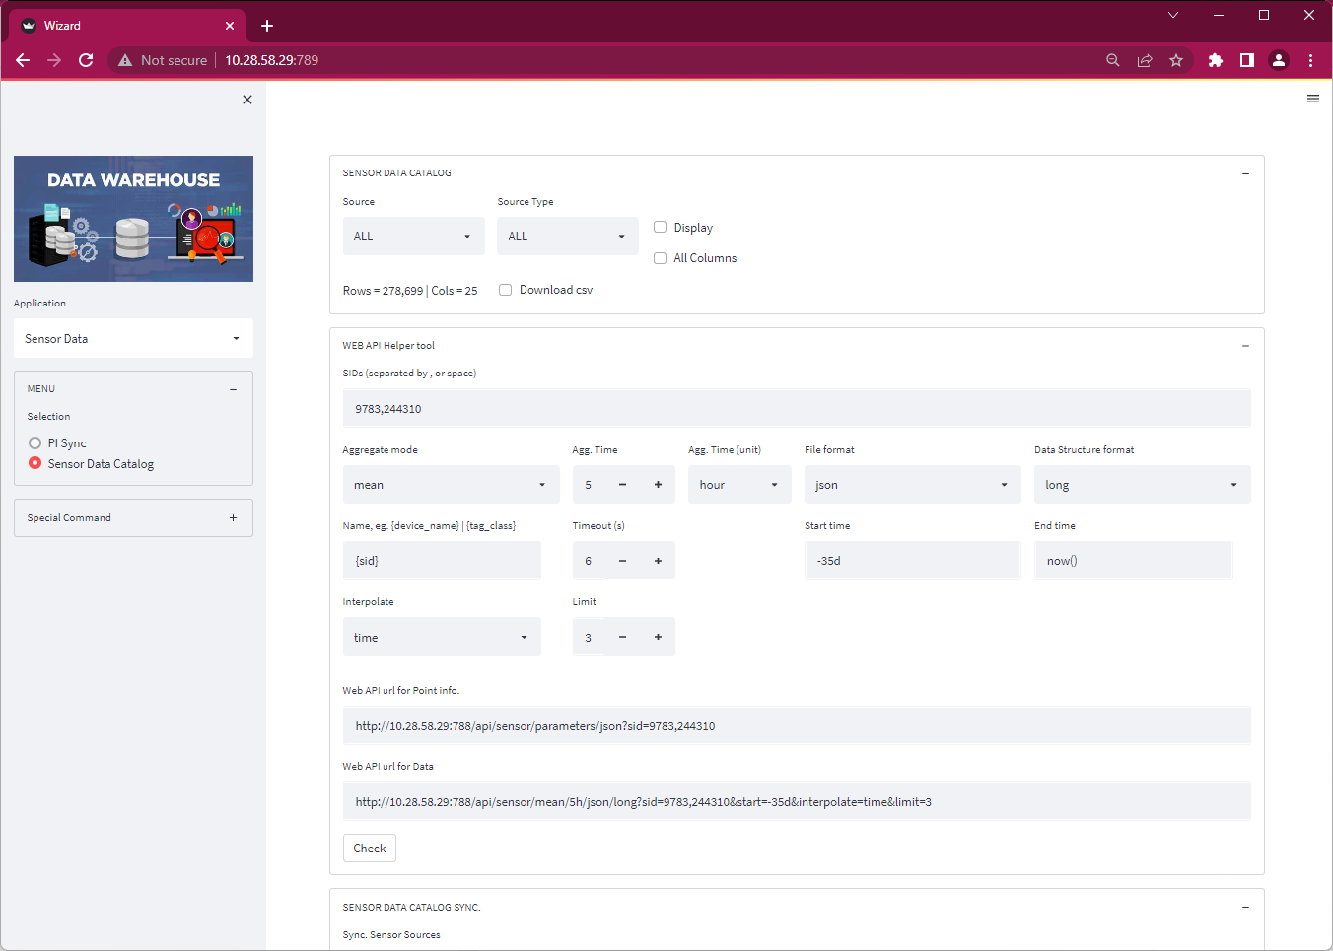
Self-Service Data Analytics Tool
Sensor Data Service Center
API Helper Tool
http://10.28.58.29:789
API Point Information
API Sensor Data
Check/Test the data

